Slide 1
Dirichlet Process
Il-Chul Moon Dept. of Industrial and Systems Engineering KAIST
icmoon@kaist.ac.kr

Slide 2
Definition of Dirichlet Process

Slide 3
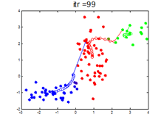

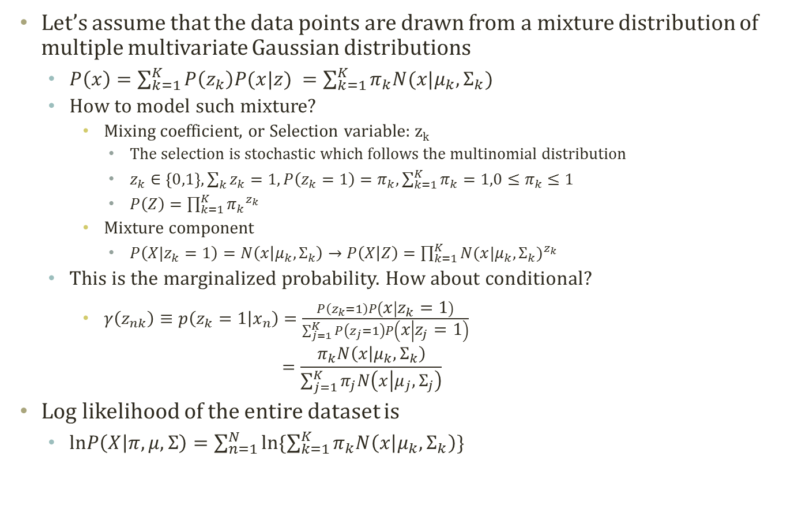


Detour: Gaussian Mixture Model
Let’s assume that the data points are drawn from a mixture distribution of multiple multivariate Gaussian distributions
$P\left(x\right)=\sum_{k=1}^{K}{P\left(z_{k}\right)P(x|z) }=\sum_{k=1}^{K}{π_{k}N(x|μ_{k},Σ_{k})}$
How to model such mixture?
Mixing coefficient, or Selection variable: z_{k}
The selection is stochastic which follows the multinomial distribution
$z_{k}∈\left\{0,1\right\}, \sum_{k}{z_{k}}=1, P\left(z_{k}=1\right)=π_{k},\sum_{k=1}^{K}{π_{k}}=1,0≤π_{k}≤1$
$P\left(Z\right)=\prod_{k=1}^{K}{{π_{k}}^{z_{k}}}$
Mixture component
$P\left(X|z_{k}=1\right)=N\left(x | μ_{k},Σ_{k}\right)→P\left(X | Z\right)=\prod_{k=1}^{K}{{N(x|μ_{k},Σ_{k})}^{z_{k}}}$
This is the marginalized probability. How about conditional?
$γ\left(z_{nk}\right)≡p\left(z_{k}=1 | x_{n}\right)=\frac{P\left(z_{k}=1\right)P\left(x | z_{k}=1\right)}{\sum_{j=1}^{K}{P\left(z_{j}=1\right)P\left(x | z_{j}=1\right)}}$ $=\frac{π_{k}N\left(x | μ_{k},Σ_{k}\right)}{\sum_{j=1}^{K}{π_{j}N\left(x | μ_{j},Σ_{j}\right)}}$
Log likelihood of the entire dataset is
$lnP\left(X | π,μ,Σ\right)=\sum_{n=1}^{N}{ln\{\sum_{k=1}^{K}{π_{k}N\left(x | μ_{k},Σ_{k}\right)}\}}$
$$π$$
z
$$μ$$
$$Σ$$
x
N

Slide 4
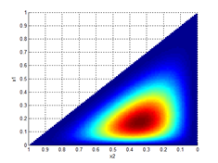
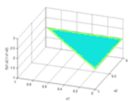
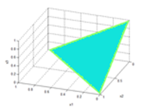
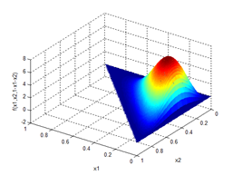
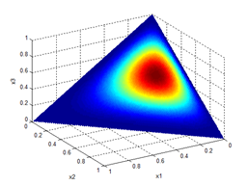
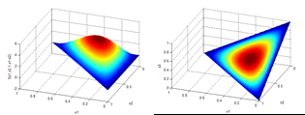
Detour: Dirichlet Distribution
Generative Process
$θ_{i}\sim Dir\left(α\right),i∈\{1,…,M\}$, $φ_{k}\sim Dir\left(β\right),k∈\{1,…,K\}$
$z_{i,l}\sim Mult\left(θ_{i}\right),i∈\left\{1,…,M\right\},l∈\left\{1,…,N\right\}$, $w_{i,l}\sim Mult\left(φ_{z_{i,l}}\right),i∈\left\{1,…,M\right\},l∈\left\{1,…,N\right\}$
Dirichlet Distribution
$P\left(x_{1},…,x_{K} | α_{1},…,α_{K}\right)=\frac{Γ(\sum_{i=1}^{K}{α_{i}}) }{\prod_{i=1}^{K}{Γ(α_{i})}}{x_{i}}^{α_{i}−1}$
$x_{1},…,x_{K−1}>0$
$x_{1}+…+x_{K−1}<1$
$x_{K}=1−x_{1}−…−x_{K−1}$
$α_{i}>0$
$$α$$
$$θ$$
z
w
$$β$$
N
M
$$\left[α_{1},α_{2},α_{3}\right]=[1,1,1]$$
$$\left[α_{1},α_{2},α_{3}\right]=[2,3,4]$$
$$\left[α_{1},α_{2},α_{3}\right]=[2,2,2]$$

Slide 5
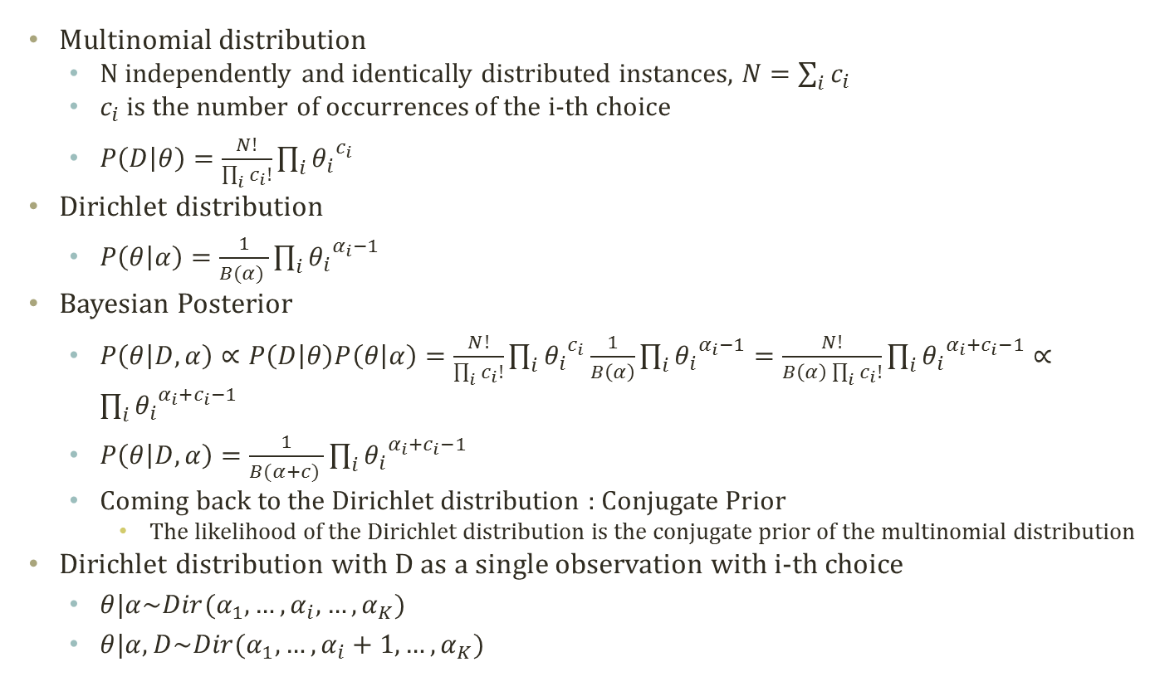
Multinomial-Dirichlet Conjugate Relation
Multinomial distribution
N independently and identically distributed instances, $N=\sum_{i}{c_{i}}$
$c_{i}$ is the number of occurrences of the i-th choice
$P\left(D | θ\right)=\frac{N!}{\prod_{i}{c_{i}!}}\prod_{i}{{θ_{i}}^{c_{i}}}$
Dirichlet distribution
$P\left(θ | α\right)=\frac{1}{B(α) }\prod_{i}{{θ_{i}}^{α_{i}−1}}$
Bayesian Posterior
$P\left(θ | D,α\right)∝P\left(D | θ\right)P\left(θ | α\right)=\frac{N!}{\prod_{i}{c_{i}!}}\prod_{i}{{θ_{i}}^{c_{i}}}\frac{1}{B\left(α\right)}\prod_{i}{{θ_{i}}^{α_{i}−1}}=\frac{N!}{B\left(α\right)\prod_{i}{c_{i}!}}\prod_{i}{{θ_{i}}^{α_{i}+c_{i}−1}}∝\prod_{i}{{θ_{i}}^{α_{i}+c_{i}−1}}$
$P\left(θ | D,α\right)=\frac{1}{B(α+c) }\prod_{i}{{θ_{i}}^{α_{i}+c_{i}−1}}$
Coming back to the Dirichlet distribution : Conjugate Prior
The likelihood of the Dirichlet distribution is the conjugate prior of the multinomial distribution
Dirichlet distribution with D as a single observation with i-th choice
$θ|α\sim Dir(α_{1},…,α_{i},…,α_{K})$
$θ|α,D\sim Dir(α_{1},…,α_{i}+1,…,α_{K})$

Slide 6


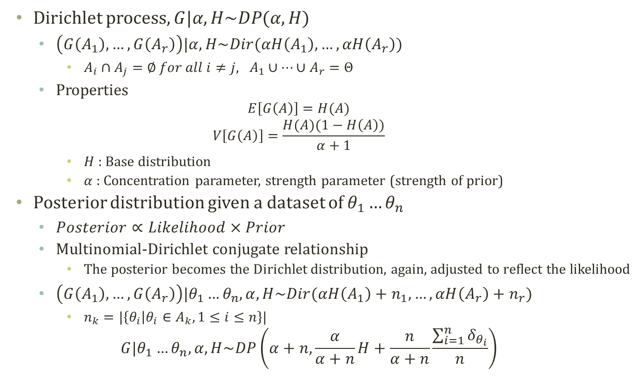
Dirichlet Process
Dirichlet process, $G|α,H\sim DP(α,H)$
$\left(G\left(A_{1}\right),…,G\left(A_{r}\right)\right)|α,H\sim Dir(αH\left(A_{1}\right),…,αH\left(A_{r}\right))$
$A_{i}∩A_{j}=∅ for all i≠j, A_{1}∪…∪A_{r}=Θ$
Properties
$$E\left[G\left(A\right)\right]=H(A)$$
$$V\left[G\left(A\right)\right]=\frac{H(A)(1−H\left(A\right))}{α+1}$$
$H$ : Base distribution
$α$ : Concentration parameter, strength parameter (strength of prior)
Posterior distribution given a dataset of $θ_{1}…θ_{n}$
$Posterior∝Likelihood×Prior$
Multinomial-Dirichlet conjugate relationship
The posterior becomes the Dirichlet distribution, again, adjusted to reflect the likelihood
$\left(G\left(A_{1}\right),…,G\left(A_{r}\right)\right)|θ_{1}…θ_{n},α,H\sim Dir(αH\left(A_{1}\right)+n_{1},…,αH\left(A_{r}\right)+n_{r})$
$n_{k}=|\left\{θ_{i} | θ_{i}∈A_{k}, 1≤i≤n\right\}|$
$$G|θ_{1}…θ_{n},α,H\sim DP\left(α+n,\frac{α}{α+n}H+\frac{n}{α+n}\frac{\sum_{i=1}^{n}{δ_{θ_{i}}}}{n}\right)$$
$$Dir(2,3,4)$$

Slide 7
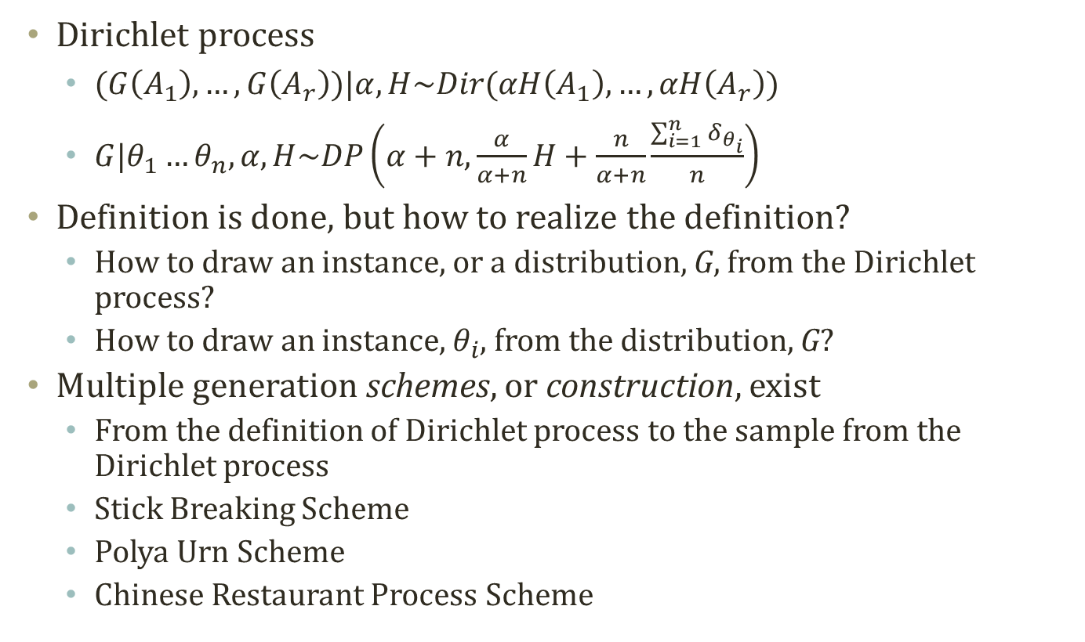
Sampling from Dirichlet Process
Dirichlet process
$(G\left(A_{1}\right),…,G\left(A_{r}\right))|α,H\sim Dir(αH\left(A_{1}\right),…,αH\left(A_{r}\right))$
$G|θ_{1}…θ_{n},α,H\sim DP\left(α+n,\frac{α}{α+n}H+\frac{n}{α+n}\frac{\sum_{i=1}^{n}{δ_{θ_{i}}}}{n}\right)$
Definition is done, but how to realize the definition?
How to draw an instance, or a distribution, G, from the Dirichlet process?
How to draw an instance, $θ_{i}$, from the distribution, G?
Multiple generation schemes, or construction, exist
From the definition of Dirichlet process to the sample from the Dirichlet process
Stick Breaking Scheme
Polya Urn Scheme
Chinese Restaurant Process Scheme

Slide 8
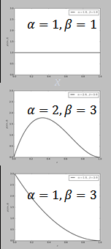
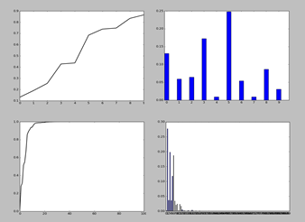
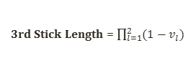




Stick-Breaking Construction
Imagine that we create a probability mass function on infinite choices
$k=1,2,…,∞$
$v_{k}|α\sim Beta\left(1,α\right)$
$β_{k}=v_{k}\prod_{l=1}^{k−1}{(1−v_{l})}$
Common notation is
$β\sim GEM(α)$
We were constructing a distribution for the Dirichlet process
$G|α,H\sim DP(α,H)$
$β\sim GEM\left(α\right)$
$G=\sum_{k=1}^{∞}{β_{k}δ_{θ_{k}}}$
$θ_{k}|H\sim H$
$θ_{k}$ chooses a n-th broken stick, and the stick length is the prob.
We know the existence of the infinite-th stick length.
Exponential growth in CDF
Discount the growth
Pitman-Yor Process
Close to Power law dist.
Useful for language models…
First Stick Length = 1
Second Stick Length = 1-$v_{1}$
$$β_{1}=v_{1}$$
3rd Stick Length = $\prod_{l=1}^{2}{(1−v_{l})}$
$$β_{2}=v_{2}(1−v_{1})$$

Slide 9

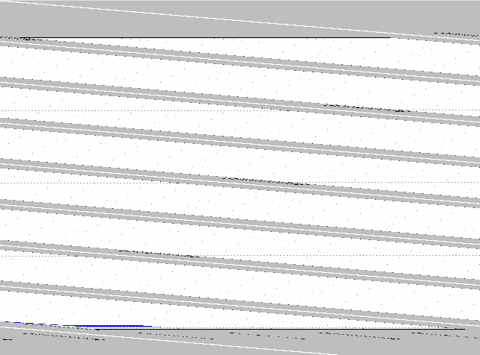
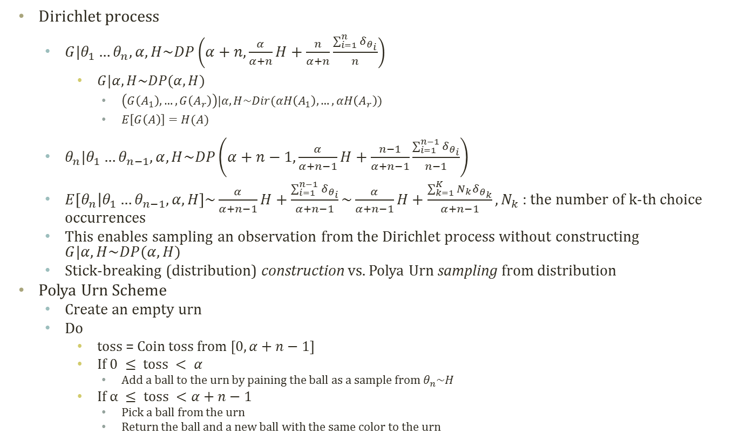


Polya Urn Scheme
$$α=4$$
$$α=10$$
Dirichlet process
$G|θ_{1}…θ_{n},α,H\sim DP\left(α+n,\frac{α}{α+n}H+\frac{n}{α+n}\frac{\sum_{i=1}^{n}{δ_{θ_{i}}}}{n}\right)$
$G|α,H\sim DP(α,H)$
$\left(G\left(A_{1}\right),…,G\left(A_{r}\right)\right)|α,H\sim Dir(αH\left(A_{1}\right),…,αH\left(A_{r}\right))$
$E\left[G\left(A\right)\right]=H(A)$
$θ_{n}|θ_{1}…θ_{n−1},α,H\sim DP\left(α+n−1,\frac{α}{α+n−1}H+\frac{n−1}{α+n−1}\frac{\sum_{i=1}^{n−1}{δ_{θ_{i}}}}{n−1}\right)$
$E\left[θ_{n} | θ_{1}…θ_{n−1},α,H\right]\sim \frac{α}{α+n−1}H+\frac{\sum_{i=1}^{n−1}{δ_{θ_{i}}}}{α+n−1}\sim \frac{α}{α+n−1}H+\frac{\sum_{k=1}^{K}{N_{k}δ_{θ_{k}}}}{α+n−1}, N_{k}$ : the number of k-th choice occurrences
This enables sampling an observation from the Dirichlet process without constructing $G|α,H\sim DP(α,H)$
Stick-breaking (distribution) construction vs. Polya Urn sampling from distribution
Polya Urn Scheme
Create an empty urn
Do
toss = Coin toss from $[0,α+n−1]$
If $0 ≤ toss < α$
Add a ball to the urn by paining the ball as a sample from $θ_{n}\sim H$
If $α ≤ toss <α+n−1$
Pick a ball from the urn
Return the ball and a new ball with the same color to the urn

Slide 10

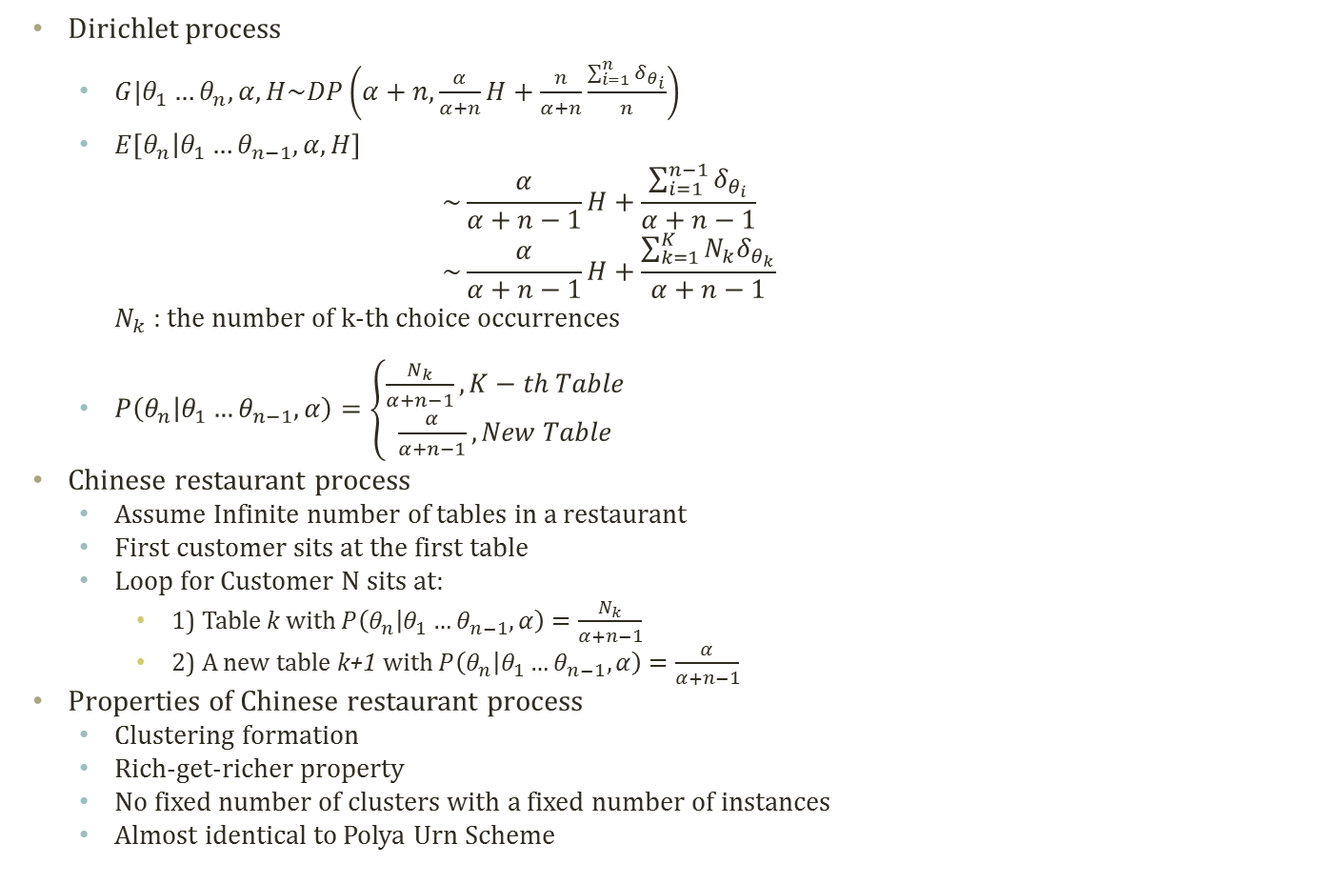


Chinese Restaurant Process
Dirichlet process
$G|θ_{1}…θ_{n},α,H\sim DP\left(α+n,\frac{α}{α+n}H+\frac{n}{α+n}\frac{\sum_{i=1}^{n}{δ_{θ_{i}}}}{n}\right)$
$E\left[θ_{n} | θ_{1}…θ_{n−1},α,H\right]$ $\sim \frac{α}{α+n−1}H+\frac{\sum_{i=1}^{n−1}{δ_{θ_{i}}}}{α+n−1}$ $\sim \frac{α}{α+n−1}H+\frac{\sum_{k=1}^{K}{N_{k}δ_{θ_{k}}}}{α+n−1}$ $N_{k}$ : the number of k-th choice occurrences
$P\left(θ_{n} | θ_{1}…θ_{n−1},α\right)=\left\{\begin{aligned}\frac{N_{k}}{α+n−1}, K−th Table \\ \frac{α}{α+n−1}, New Table\end{aligned}\right.$
Chinese restaurant process
Assume Infinite number of tables in a restaurant
First customer sits at the first table
Loop for Customer N sits at:
1) Table k with $P\left(θ_{n} | θ_{1}…θ_{n−1},α\right)=\frac{N_{k}}{α+n−1}$
2) A new table k+1 with $P\left(θ_{n} | θ_{1}…θ_{n−1},α\right)=\frac{α}{α+n−1}$
Properties of Chinese restaurant process
Clustering formation
Rich-get-richer property
No fixed number of clusters with a fixed number of instances
Almost identical to Polya Urn Scheme
Cluster 1
Cluster 2
5th Customer enters
$$P\left(θ_{5}=C_{2} | θ_{1}…θ_{4},α\right) \\ =\frac{α}{α+4}$$
Cluster 1
Cluster 2
Cluster 3 (New)
$$P\left(θ_{5}=C_{2} | θ_{1}…θ_{4},α\right) \\ =\frac{1}{α+4}$$
$$P\left(θ_{5}=C_{1} | θ_{1}…θ_{4},α\right) \\ =\frac{3}{α+4}$$

Slide 11
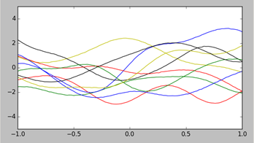
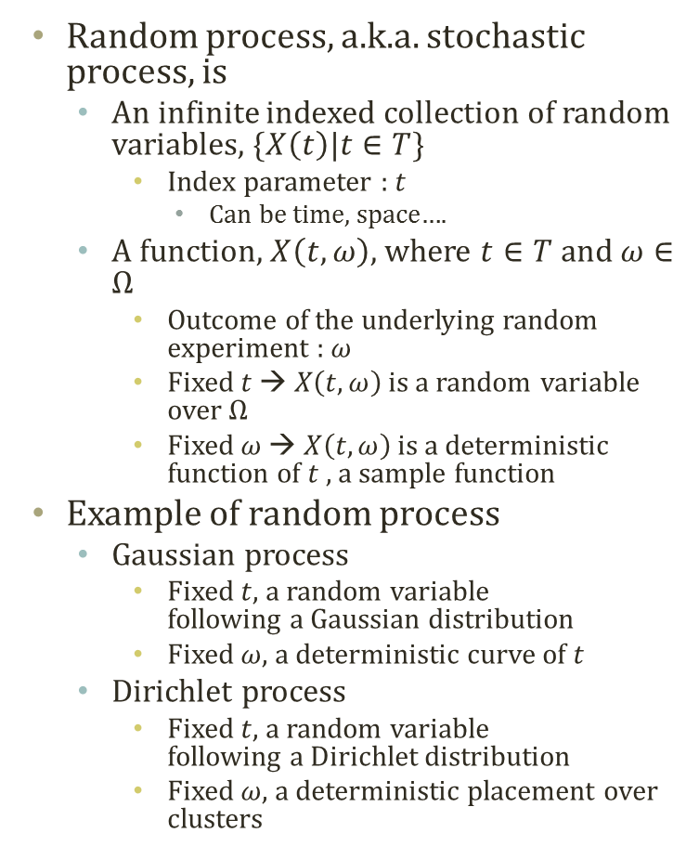



Detour: Random Process
Random process, a.k.a. stochastic process, is
An infinite indexed collection of random variables, $\{X\left(t\right)|t∈T\}$
Index parameter : $t$
Can be time, space….
A function, $X\left(t,ω\right)$, where $t∈T$ and $ω∈Ω$
Outcome of the underlying random experiment : $ω$
Fixed $t$ → $X\left(t,ω\right)$ is a random variable over $Ω$
Fixed $ω$ → $X\left(t,ω\right)$ is a deterministic function of $t$, a sample function
Example of random process
Gaussian process
Fixed $t$, a random variable following a Gaussian distribution
Fixed $ω$, a deterministic curve of $t$
Dirichlet process
Fixed $t$, a random variable following a Dirichlet distribution
Fixed $ω$, a deterministic placement over clusters
$$P\left(θ_{5}=C_{2} | θ_{1}…θ_{4},α\right) \\ =\frac{α}{α+4}$$
Cluster 1
Cluster 2
Cluster 3 (New)
$$P\left(θ_{5}=C_{2} | θ_{1}…θ_{4},α\right) \\ =\frac{1}{α+4}$$
$$P\left(θ_{5}=C_{1} | θ_{1}…θ_{4},α\right) \\ =\frac{3}{α+4}$$

Slide 12
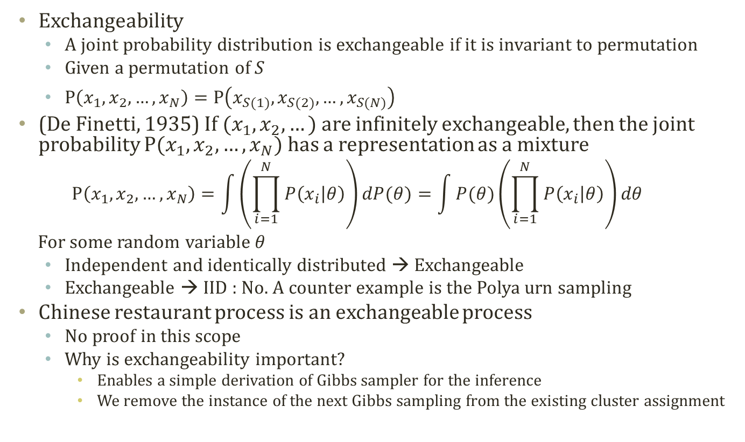
de Finetti’s Theorem
Exchangeability
A joint probability distribution is exchangeable if it is invariant to permutation
Given a permutation of S
$P\left(x_{1},x_{2},…,x_{N}\right)=P\left(x_{S(1)},x_{S(2)},…,x_{S(N)}\right)$
(De Finetti, 1935) If $(x_{1},x_{2},…)$ are infinitely exchangeable, then the joint probability $P(x_{1},x_{2},…,x_{N})$ has a representation as a mixture
$$P\left(x_{1},x_{2},…,x_{N}\right)=\int{\left(\prod_{i=1}^{N}{P\left(x_{i} | θ\right)}\right)dP(θ)}=\int{P(θ)\left(\prod_{i=1}^{N}{P\left(x_{i} | θ\right)}\right)dθ}$$
For some random variable $θ$
Independent and identically distributed → Exchangeable
Exchangeable → IID : No. A counter example is the Polya urn sampling
Chinese restaurant process is an exchangeable process
No proof in this scope
Why is exchangeability important?
Enables a simple derivation of Gibbs sampler for the inference
We remove the instance of the next Gibbs sampling from the existing cluster assignment

Slide 13



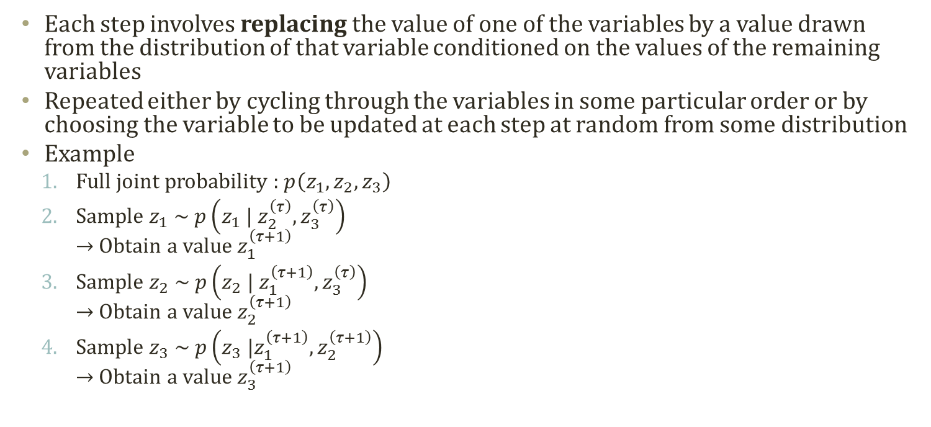



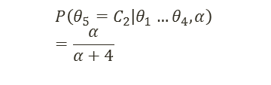
Detour: Concept of Gibbs Sampling
$$\left\{z_{1}^{\left(τ\right)},z_{2}^{\left(τ\right)},z_{3}^{\left(τ\right)}\right\}$$
$$\left\{z_{1}^{\left(τ+1\right)},z_{2}^{\left(τ\right)},z_{3}^{\left(τ\right)}\right\}$$
$$\left\{z_{1}^{\left(τ+1\right)},z_{2}^{\left(τ+1\right)},z_{3}^{\left(τ\right)}\right\}$$
$$\left\{z_{1}^{\left(τ+1\right)},z_{2}^{\left(τ+1\right)},z_{3}^{\left(τ+1\right)}\right\}$$
Each step involves replacing the value of one of the variables by a value drawn from the distribution of that variable conditioned on the values of the remaining variables
Repeated either by cycling through the variables in some particular order or by choosing the variable to be updated at each step at random from some distribution
Example
Full joint probability : $p\left(z_{1},z_{2},z_{3}\right)$
Sample $z_{1} \sim p\left(z_{1} | z_{2}^{\left(τ\right)},z_{3}^{\left(τ\right)}\right)$ → Obtain a value $z_{1}^{\left(τ+1\right)}$
Sample $z_{2} \sim p\left(z_{2} | z_{1}^{\left(τ+1\right)},z_{3}^{\left(τ\right)}\right)$ → Obtain a value $z_{2}^{\left(τ+1\right)}$
Sample $z_{3} \sim p\left(z_{3} |z_{1}^{\left(τ+1\right)},z_{2}^{\left(τ+1\right)}\right)$ → Obtain a value $z_{3}^{\left(τ+1\right)}$
$$P\left(θ_{5}=C_{2} | θ_{1}…θ_{4},α\right) \\ =\frac{α}{α+4}$$
Cluster 1
Cluster 2
Cluster 3 (New)
$$P\left(θ_{5}=C_{2} | θ_{1}…θ_{4},α\right) \\ =\frac{1}{α+4}$$
$$P\left(θ_{5}=C_{1} | θ_{1}…θ_{4},α\right) \\ =\frac{3}{α+4}$$

Slide 14
Dirichlet Process Mixture Model

Slide 15

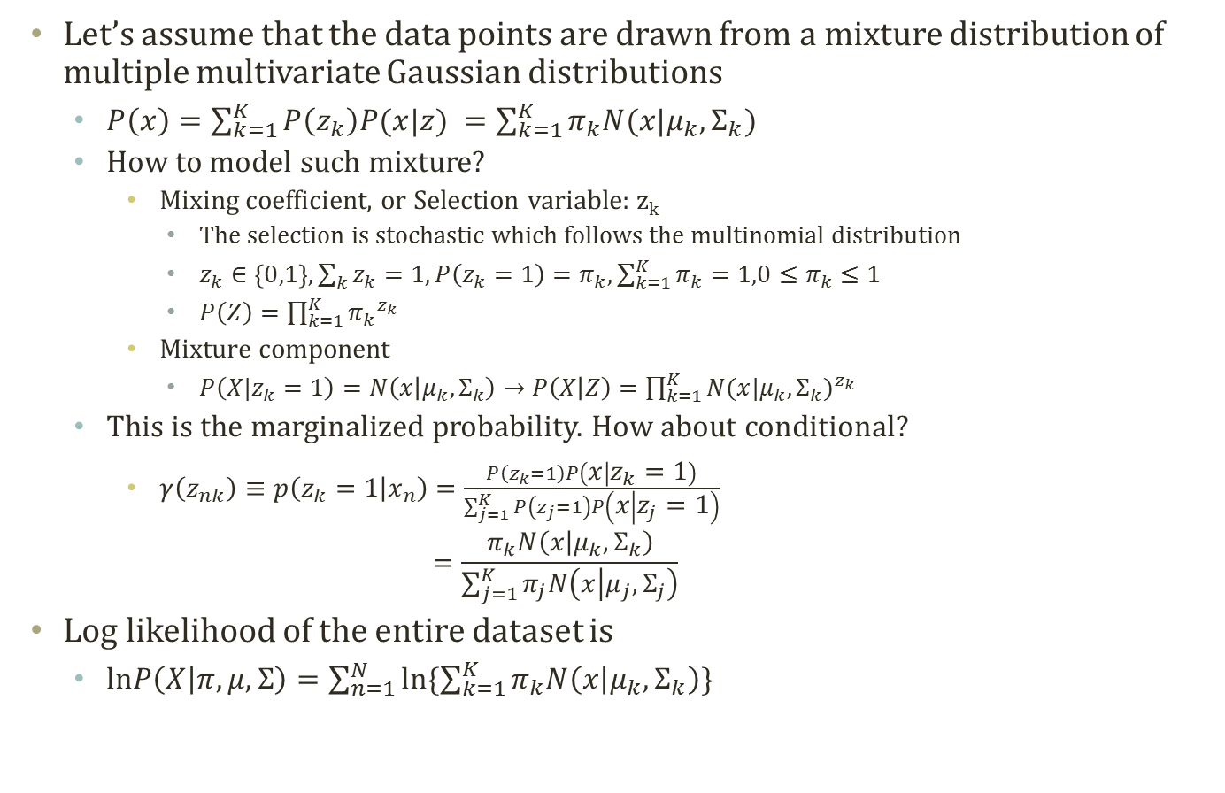


Detour: Gaussian Mixture Model
Let’s assume that the data points are drawn from a mixture distribution of multiple multivariate Gaussian distributions
$P\left(x\right)=\sum_{k=1}^{K}{P\left(z_{k}\right)P(x|z) }=\sum_{k=1}^{K}{π_{k}N(x|μ_{k},Σ_{k})}$
How to model such mixture?
Mixing coefficient, or Selection variable: z_{k}
The selection is stochastic which follows the multinomial distribution
$z_{k}∈\left\{0,1\right\}, \sum_{k}{z_{k}}=1, P\left(z_{k}=1\right)=π_{k},\sum_{k=1}^{K}{π_{k}}=1,0≤π_{k}≤1$
$P\left(Z\right)=\prod_{k=1}^{K}{{π_{k}}^{z_{k}}}$
Mixture component
$P\left(X|z_{k}=1\right)=N\left(x | μ_{k},Σ_{k}\right)→P\left(X | Z\right)=\prod_{k=1}^{K}{{N(x|μ_{k},Σ_{k})}^{z_{k}}}$
This is the marginalized probability. How about conditional?
$γ\left(z_{nk}\right)≡p\left(z_{k}=1 | x_{n}\right)=\frac{P\left(z_{k}=1\right)P\left(x | z_{k}=1\right)}{\sum_{j=1}^{K}{P\left(z_{j}=1\right)P\left(x | z_{j}=1\right)}}$ $=\frac{π_{k}N\left(x | μ_{k},Σ_{k}\right)}{\sum_{j=1}^{K}{π_{j}N\left(x | μ_{j},Σ_{j}\right)}}$
Log likelihood of the entire dataset is
$lnP\left(X | π,μ,Σ\right)=\sum_{n=1}^{N}{ln\{\sum_{k=1}^{K}{π_{k}N\left(x | μ_{k},Σ_{k}\right)}\}}$
$$π$$
z
$$μ$$
$$Σ$$
x
N

Slide 16





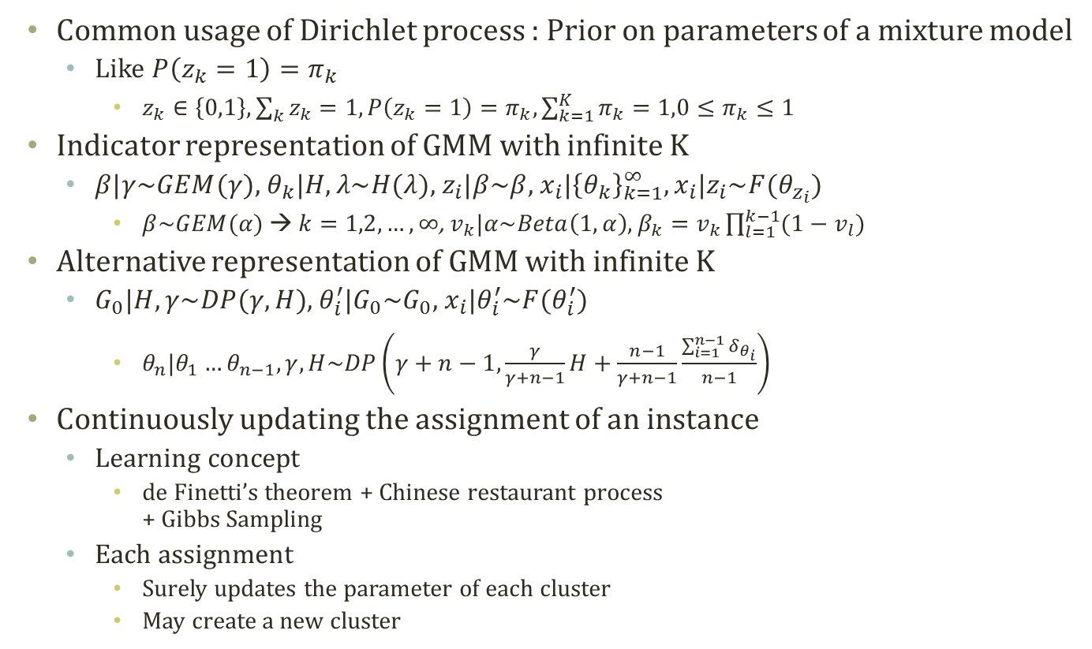







Dirichlet Process Mixture Model
$$π$$
$$μ$$
z
$$Σ$$
x
N
GMM
Common usage of Dirichlet process : Prior on parameters of a mixture model
Like $P\left(z_{k}=1\right)=π_{k}$
$z_{k}∈\left\{0,1\right\}, \sum_{k}{z_{k}}=1, P\left(z_{k}=1\right)=π_{k},\sum_{k=1}^{K}{π_{k}}=1,0≤π_{k}≤1$
Indicator representation of GMM with infinite K
$β|γ\sim GEM(γ)$, $θ_{k}|H,λ\sim H(λ)$, $z_{i}|β\sim β$, $x_{i}|{\left\{θ_{k}\right\}}_{k=1}^{∞},x_{i}|z_{i}\sim F(θ_{z_{i}})$
$β\sim GEM(α)$ → $k=1,2,…,∞$, $v_{k}|α\sim Beta\left(1,α\right)$, $β_{k}=v_{k}\prod_{l=1}^{k−1}{(1−v_{l})}$
Alternative representation of GMM with infinite K
$G_{0}|H,γ\sim DP(γ,H)$, $θ_{i}^{′}|G_{0}\sim G_{0}$, $x_{i}|θ_{i}^{′}\sim F(θ_{i}^{′})$
$θ_{n}|θ_{1}…θ_{n−1},γ,H\sim DP\left(γ+n−1,\frac{γ}{γ+n−1}H+\frac{n−1}{γ+n−1}\frac{\sum_{i=1}^{n−1}{δ_{θ_{i}}}}{n−1}\right)$
Continuously updating the assignment of an instance
Learning concept
de Finetti’s theorem + Chinese restaurant process + Gibbs Sampling
Each assignment
Surely updates the parameter of each cluster
May create a new cluster
Alternative Representation
For Mixture Models
Indicator View
Graphical Model
$$H(λ)$$
$$γ$$
$$β$$
$$γ$$
$$G_{0}$$
$$λ$$
z
$$θ^{′}$$
$$θ$$
x
x
$$∞$$
N
N

Slide 17








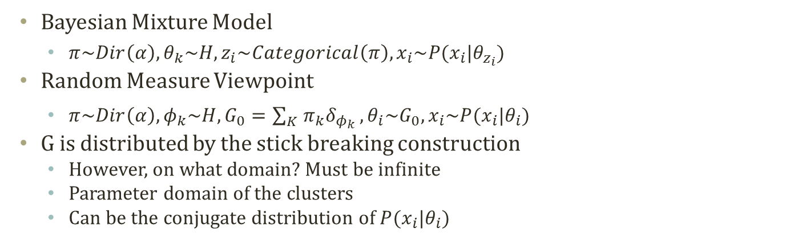











Alternatives in Formulating Mixture Models
$$α$$
$$H$$
$$α$$
$$Θ$$
$$π$$
$$θ$$
$$G_{0}$$
H
$H$ : Base Distribution
K
$G_{0}$: Dirichlet Prior Dist.
z
$$x$$
$$θ$$
$$x$$
N
N
Bayesian Mixture Model
Random Measure Viewpoint
$$θ_{1}$$
$$θ_{2}$$
$$θ_{4}$$
$$θ_{5}$$
$$θ_{6}$$
$$θ_{7}$$
$$θ_{3}$$
$$Θ$$
Bayesian Mixture Model
$π\sim Dir\left(α\right), θ_{k}\sim H, z_{i}\sim Categorical\left(π\right),x_{i}\sim P(x_{i}|θ_{z_{i}})$
Random Measure Viewpoint
$π\sim Dir\left(α\right),φ_{k}\sim H,G_{0}=\sum_{K}{π_{k}δ_{φ_{k}}},θ_{i}\sim G_{0},x_{i}\sim P(x_{i}|θ_{i})$
G is distributed by the stick breaking construction
However, on what domain? Must be infinite
Parameter domain of the clusters
Can be the conjugate distribution of $P(x_{i}|θ_{i})$
Atom : a table or a broken stick

Slide 18





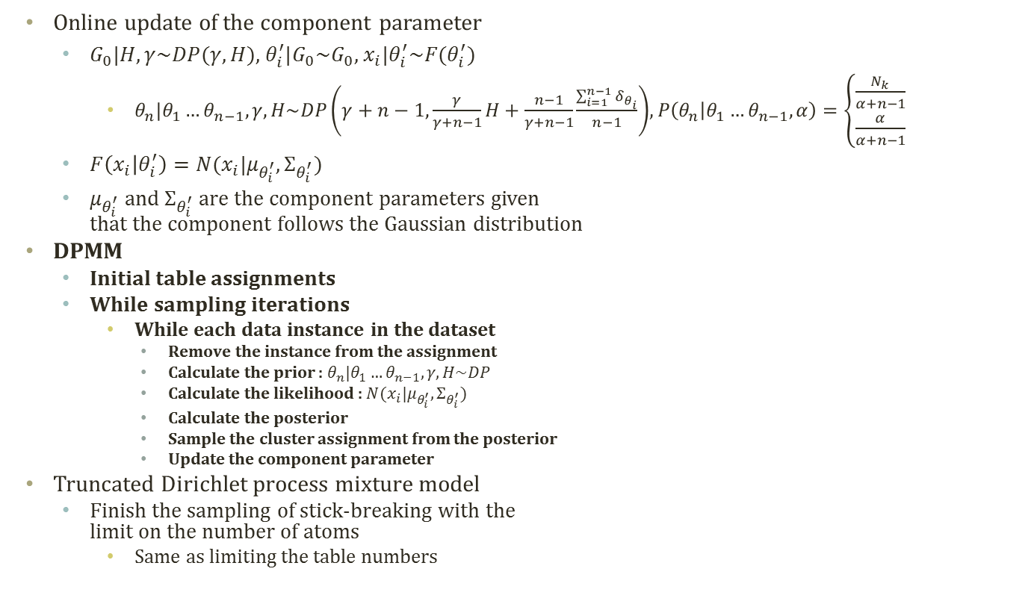







Implementation Details of DPMM
$$P\left(θ_{5}=C_{2} | θ_{1}…θ_{4},α\right) \\ =\frac{α}{α+4}$$
Cluster 1
Cluster 2
Cluster 3 (New)
Online update of the component parameter
$G_{0}|H,γ\sim DP(γ,H)\text{, }θ_{i}^{′}|G_{0}\sim G_{0}\text{, }x_{i}|θ_{i}^{′}\sim F(θ_{i}^{′})$
$θ_{n}|θ_{1}…θ_{n−1},γ,H\sim DP\left(γ+n−1,\frac{γ}{γ+n−1}H+\frac{n−1}{γ+n−1}\frac{\sum_{i=1}^{n−1}{δ_{θ_{i}}}}{n−1}\right)$, $P\left(θ_{n} | θ_{1}…θ_{n−1},α\right)=\left\{\begin{aligned}\frac{N_{k}}{α+n−1} \\ \frac{α}{α+n−1}\end{aligned}\right.$
$F\left(x_{i} | θ_{i}^{′}\right)=N(x_{i}|μ_{θ_{i}^{′}},Σ_{θ_{i}^{′}})$
$μ_{θ_{i}^{′}}$ and $Σ_{θ_{i}^{′}}$ are the component parameters given that the component follows the Gaussian distribution
DPMM
Initial table assignments
While sampling iterations
While each data instance in the dataset
Remove the instance from the assignment
Calculate the prior : $θ_{n}|θ_{1}…θ_{n−1},γ,H\sim DP$
Calculate the likelihood : $N(x_{i}|μ_{θ_{i}^{′}},Σ_{θ_{i}^{′}})$
Calculate the posterior
Sample the cluster assignment from the posterior
Update the component parameter
Truncated Dirichlet process mixture model
Finish the sampling of stick-breaking with the limit on the number of atoms
Same as limiting the table numbers
$$P\left(θ_{5}=C_{1} | θ_{1}…θ_{4},α\right) \\ =\frac{3}{α+4}$$
$$P\left(θ_{5}=C_{2} | θ_{1}…θ_{4},α\right) \\ =\frac{1}{α+4}$$
Alternative Representation
For Mixture Models
Indicator View
Graphical Model
$$H(λ)$$
$$γ$$
$$β$$
$$γ$$
$$G_{0}$$
$$λ$$
z
$$θ^{′}$$
$$θ$$
x
x
$$∞$$
N
N

Slide 19
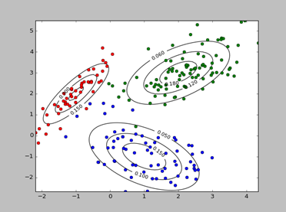
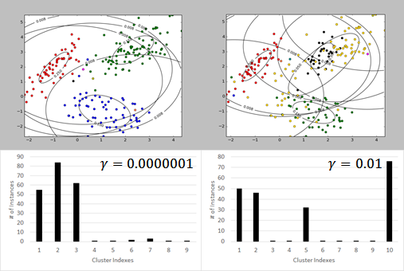
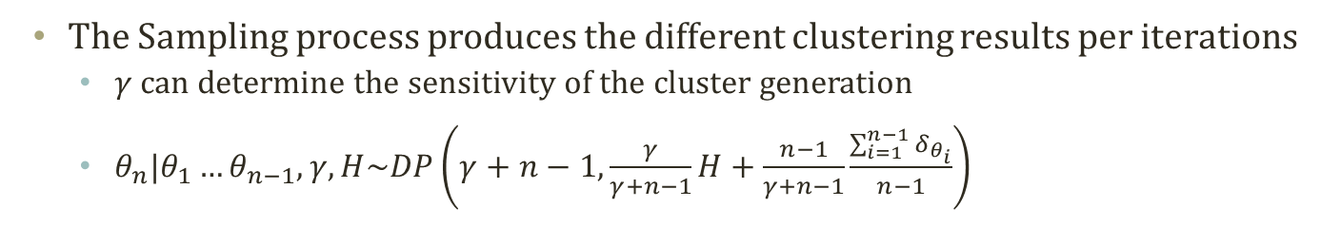
DPMM Sampling Process
The Sampling process produces the different clustering results per iterations
$γ$ can determine the sensitivity of the cluster generation
$θ_{n}|θ_{1}…θ_{n−1},γ,H\sim DP\left(γ+n−1,\frac{γ}{γ+n−1}H+\frac{n−1}{γ+n−1}\frac{\sum_{i=1}^{n−1}{δ_{θ_{i}}}}{n−1}\right)$
Synthesized True Dataset

Slide 20
Hierarchical Dirichlet Process

Slide 21








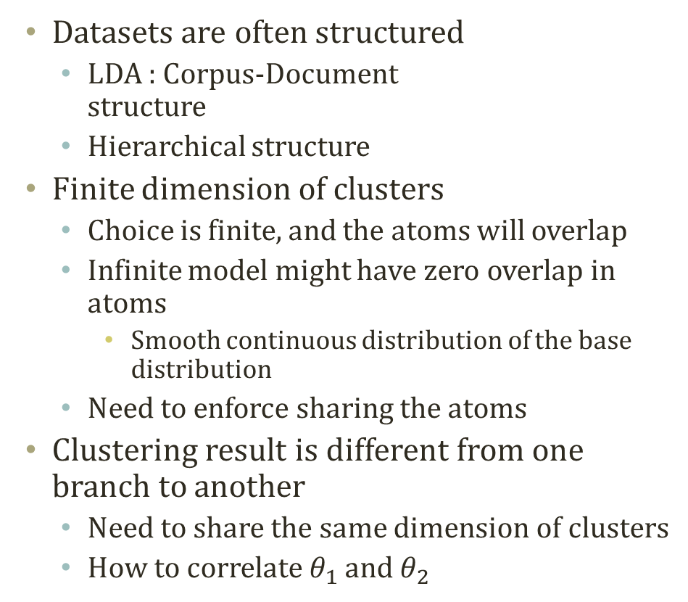











Problem of Separate Prior
$$π$$
$$α$$
$$θ$$
z
w
$$β$$
N
M
z
$$μ$$
Datasets are often structured
LDA : Corpus-Document structure
Hierarchical structure
Finite dimension of clusters
Choice is finite, and the atoms will overlap
Infinite model might have zero overlap in atoms
Smooth continuous distribution of the base distribution
Need to enforce sharing the atoms
Clustering result is different from one branch to another
Need to share the same dimension of clusters
How to correlate $θ_{1}$ and $θ_{2}$
$$Σ$$
x
N
$$α$$
$$θ1$$
$$θ2$$
<0.1,0.2,0.7>
z
z
<0.4,0.3,0.3>
w
w
$$H(λ)$$
N₁
N₂
$$γ$$
$$G_{0}$$
$H$ : Base Distribution
$$Θ$$
$$θ^{′}$$
x
$$θ_{1}$$
$$θ_{2}$$
$$θ_{4}$$
$$θ_{5}$$
$$θ_{6}$$
$$θ_{7}$$
$$θ_{3}$$
$$Θ$$
N
$G_{0}$: Dirichlet Prior Dist.

Slide 22











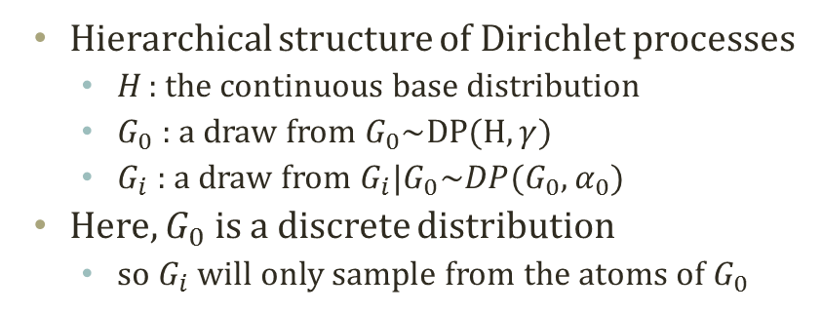

















Solution of Atom Sharing
$$H$$
$$γ$$
$$G_{0}$$
$$α_{0}$$
$$G_{0}$$
$$α_{0}$$
$$α$$
$$θ1$$
$$θ2$$
$$G1$$
$$G2$$
$$G1$$
$$G2$$
z
z
$$θ1$$
$$θ2$$
$$θ1$$
$$θ2$$
w
w
w
w
w
w
N₁
N₂
N₁
N₂
N₁
N₂
Parametric LDA
Non-Parametric LDA without Atom Sharing
Non-Parametric LDA with Atom Sharing
Hierarchical structure of Dirichlet processes
H : the continuous base distribution
$G_{0}$ : a draw from $G_{0}\sim DP(H,γ)$
$G_{i}$ : a draw from $G_{i}|G_{0}\sim DP(G_{0},α_{0})$
Here, $G_{0}$ is a discrete distribution
so $G_{i}$ will only sample from the atoms of $G_{0}$
$$Θ$$
$$Θ$$
$H$ : Base Distribution
$G_{1}$: Dirichlet Prior Dist.
$$θ_{1}$$
$$θ_{2}$$
$$θ_{4}$$
$$θ_{5}$$
$$θ_{6}$$
$$θ_{7}$$
$$Θ$$
$$θ_{3}$$
$$Θ$$
$G_{0}$: Dirichlet Prior Dist.
$G_{2}$: Dirichlet Prior Dist.

Slide 23



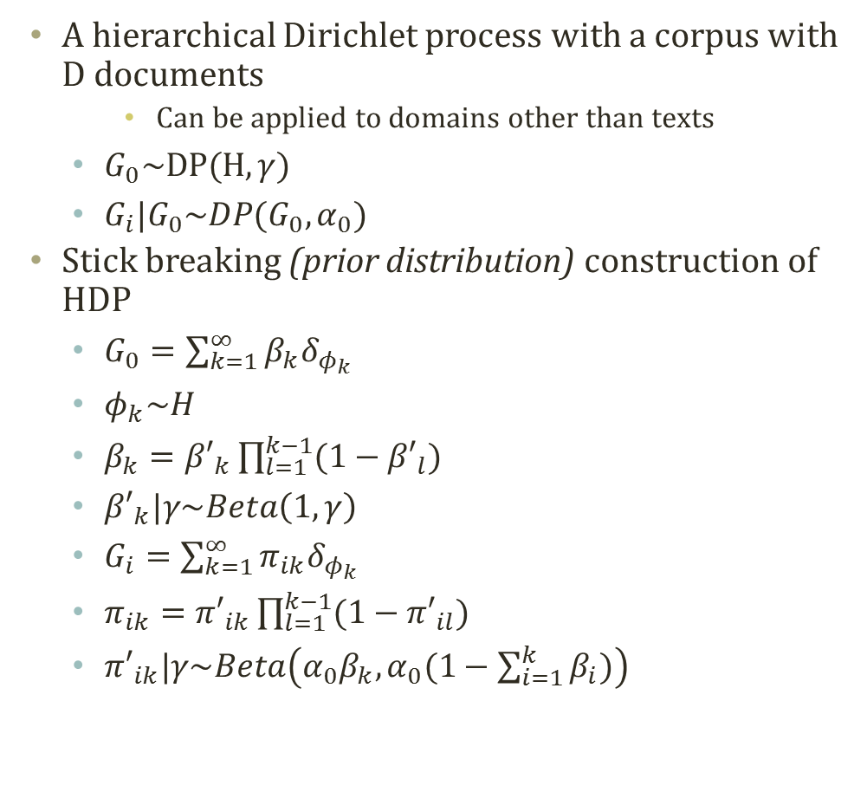




Stick Breaking Construction
A hierarchical Dirichlet process with a corpus with D documents
Can be applied to domains other than texts
$G_{0}\sim DP(H,γ)$
$G_{i}|G_{0}\sim DP(G_{0},α_{0})$
Stick breaking (prior distribution) construction of HDP
$G_{0}=\sum_{k=1}^{∞}{β_{k}δ_{φ_{k}}}$
$φ_{k}\sim H$
$β_{k}={β′}_{k}\prod_{l=1}^{k−1}{(1−{β′}_{l})}$
${β′}_{k}|γ\sim Beta\left(1,γ\right)$
$G_{i}=\sum_{k=1}^{∞}{π_{ik}δ_{φ_{k}}}$
$π_{ik}={π′}_{ik}\prod_{l=1}^{k−1}{(1−{π′}_{il})}$
${π′}_{ik}|γ\sim Beta\left(α_{0}β_{k},α_{0}(1−\sum_{i=1}^{k}{β_{i}})\right)$
$$H$$
$$γ$$
$$G_{0}$$
$$α_{0}$$
$$Gi$$
$φ_{k}\sim H$ is shared
$$θ$$
w
N
D
Hierarchical Dirichlet Process

Slide 24












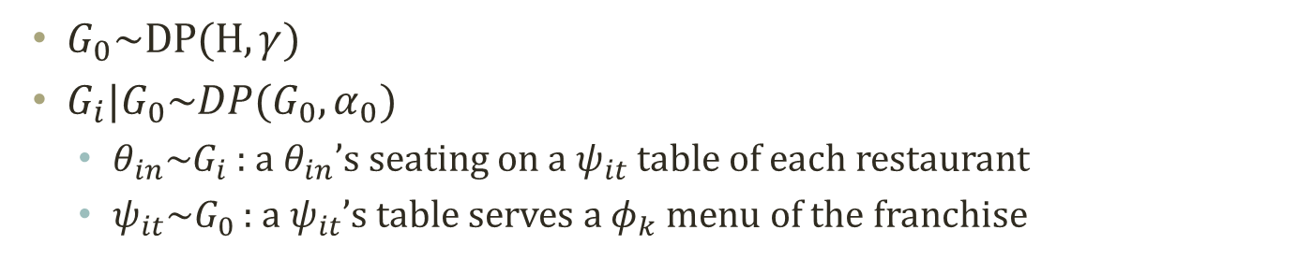

























Chinese Restaurant Franchise
$$H$$
$$γ$$
$$G_{0}$$
$G_{0}\sim DP(H,γ)$
$G_{i}|G_{0}\sim DP(G_{0},α_{0})$
$θ_{in}\sim G_{i}$ : a $θ_{in}$’s seating on a $ψ_{it}$ table of each restaurant
$ψ_{it}\sim G_{0}$ : a $ψ_{it}$’s table serves a $φ_{k}$ menu of the franchise
$$α_{0}$$
$$Gi$$
$$θ$$
$$θ_{13}$$
w
$$θ_{11}$$
CRP Sampling
N
D
$$ψ_{11}=φ_{1}$$
$$ψ_{12}=φ_{3}$$
$$ψ_{13}$$ $=$?
$$θ_{12}$$
$$φ_{1}$$
$$φ_{2}$$
$$φ_{3}$$
$$θ_{14}$$
D=1
$$ψ_{11}$$
$$ψ_{12}$$
$$ψ_{21}$$
$$ψ_{22}$$
$$ψ_{23}$$
$$θ_{21}$$
$$θ_{23}$$
$$θ_{24}$$
$$ψ_{21}=φ_{2}$$
$$ψ_{22}=φ_{3}$$
$$ψ_{23} \\ =φ_{1}$$
$$ψ_{13}$$ $=$?
$$θ_{11}$$
$$θ_{12}$$
$$θ_{13}$$
$$θ_{14}$$
$$θ_{21}$$
$$θ_{22}$$
$$θ_{23}$$
$$θ_{24}$$
CRP Sampling
CRP Sampling
$$θ_{22}$$
D=2

